Slide 1
Lesson 3: Constants/Literals
By: Ryan Alterman
Revised: 8-27-17

Slide 2
What are Constants/Literals?
Constants refer to values that are fixed
They can not be changed
Also called literals
Literals can be any of the basic data types
Integer
Floating-point
Characters
Strings
Booleans
Treated just like normal variables
Just the value can not be changed

Slide 3
Integer Literals
These can be 1 of three different value types
These types are specified with a prefix
0x or 0X(same meaning) for hexadecimal values
Hexadecimals are for coding color values
0 for octal values
Just another way to interpret ASCII values(we will most likely never use these)
No prefix for decimal values.
You can also have a suffix so that you can specify long or unsigned
U or u(same meaning) for unsigned
L or l(same meaning) for long
Note: you can not repeat the letter of a suffix
So UU is not legal, but UL is.

Slide 4
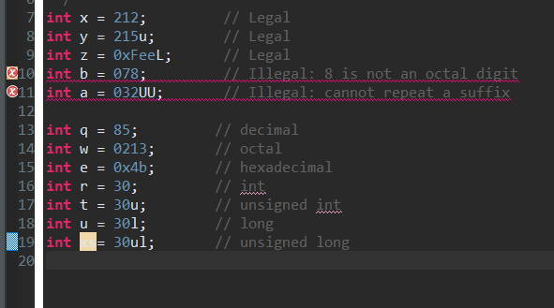
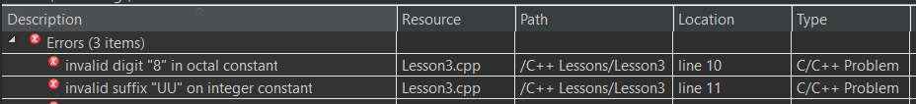
Code example of integer literals

Slide 5
Floating-point Literals
Have a couple of parts actually in the number itself
Has an integer
A decimal or a fraction
And an exponent
Can be represented as a decimal or exponential form
Here’s how you represent an exponent
E or e( it doesn’t care, it will take both)

Slide 6
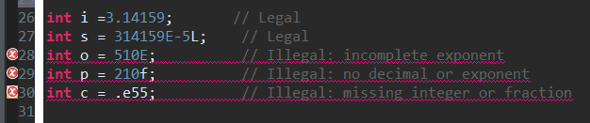
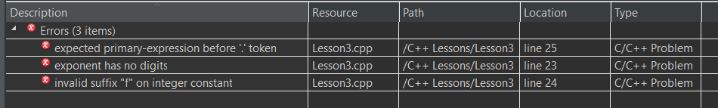
Code example of floating-point literals

Slide 7
Boolean Literals
Boolean literals can only have two values
True or False
And they are written using the keywords:
True
False

Slide 8
Defining Constants
There are two ways to define constants in C++
Using #define
Which is a preprocessor, like #include
It follows a format: #define identifier value
Is put around the beginning of the code, around where the include files are
Using const
It is a keyword
Put it right before the variable type
This allows you to define the variable type
Follows a format: const type variable = value;
Always define constants with CAPITALS

Slide 9
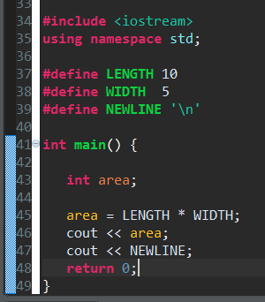
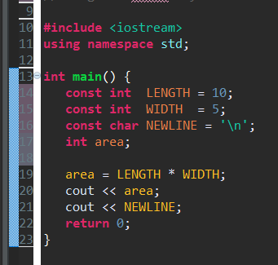
Code example of #define preprocessor and const keyword

Slide 10
Challenge
Take a look at the programs you made in the last challenge. See if you can find which variables you made are Literals(if any). Then I want you to try making some of each type of literal(except for octals).

Slide 11
Next: Storage Classes

